Slide 1
IoT Using LoRaWAN
CSE3PRB - Team F

Slide 2

Team
Michael Owczarek
Joel Morran
Remi Petit
James Curnow
Luis Shigetomi
Notes:
Introduce self. Forget about roles.

Slide 3
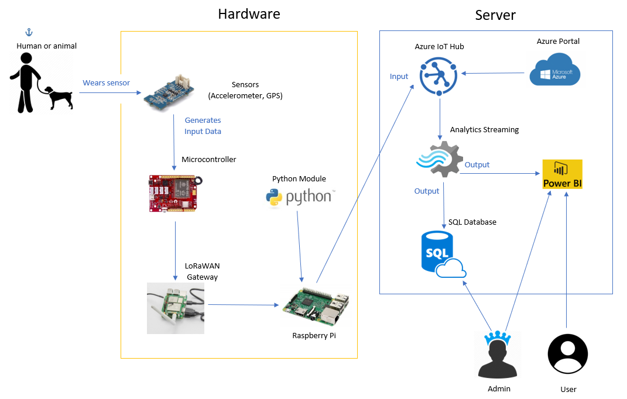
System Overview
Notes:
MICHAEL

Slide 4
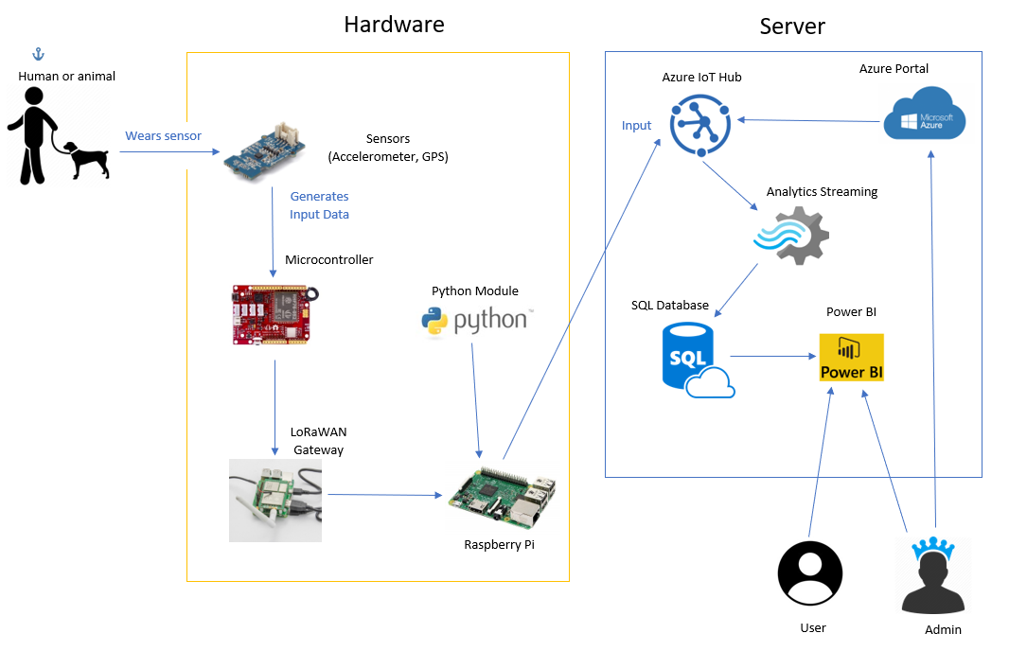
System Overview
Notes:
MICHAEL

Slide 5
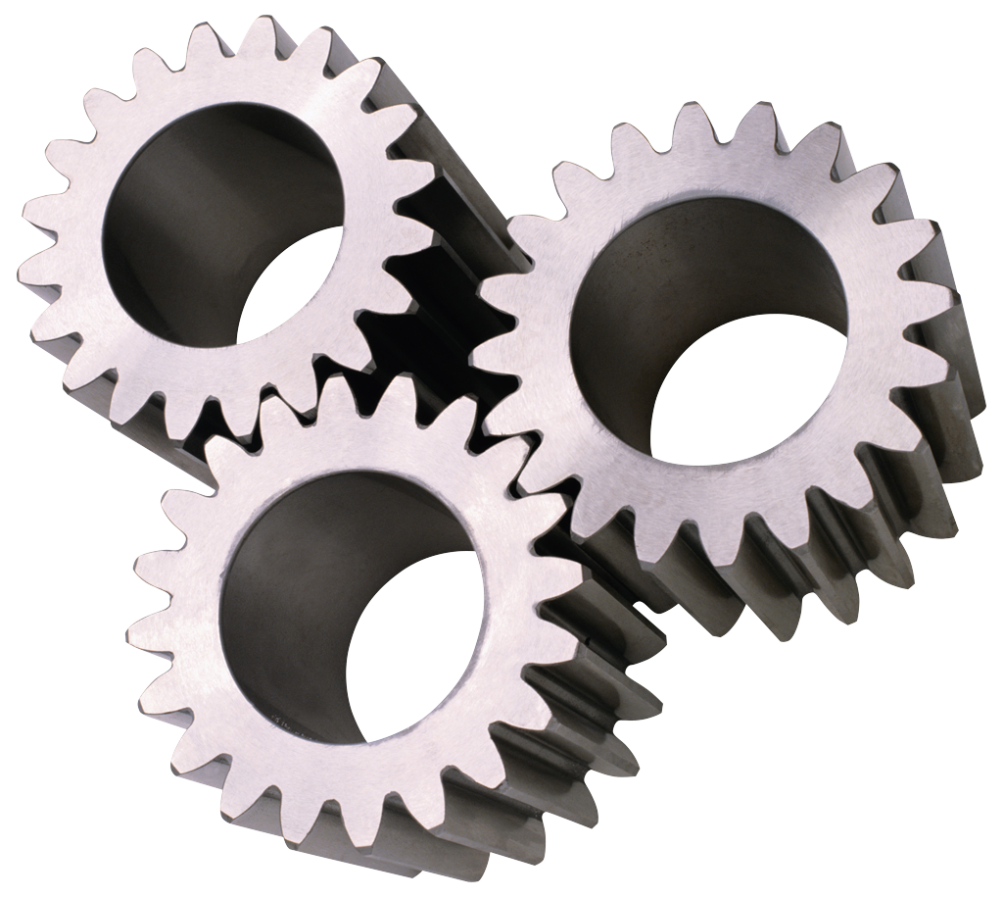
Other Modifications & Improvements
Revised user stories
Further simplified SQL database
Power BI changes
Revised Jira story point allocation
Notes:
MICHAEL

Slide 6

Agile (Old User Stories)
As a User I want…
Clean UI / Easy to understand
Easy setup (hardware & software)
Cost effective
Data easy to export
Notes:
LUIS

Slide 7
Agile (New User Stories)
As a User I want to…
View a pie chart of the subject’s behaviour
View a heatmap of the subject’s location
Filter data by a chosen date range
Notes:
LUIS

Slide 8
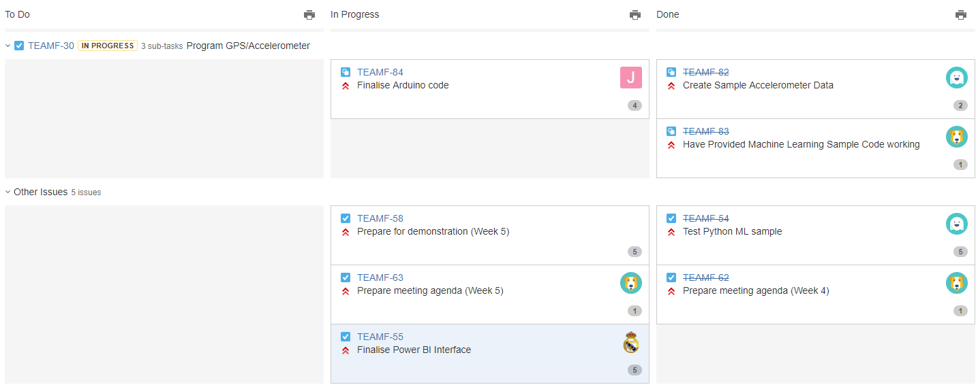
Agile (Jira)
Notes:
REMI
- Explain how the team can/has improved.
- Explain how the team can/has improved.

Slide 9
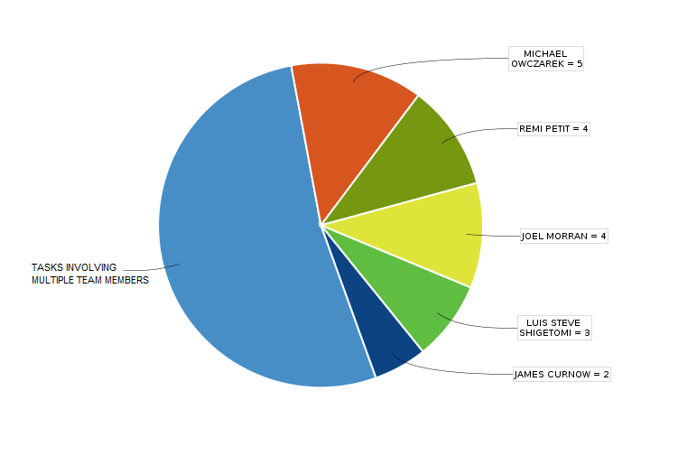
Agile (Jira)
Notes:
REMI

Slide 10
Implementation
Hardware sensor
Machine learning
Power BI & SQL Database (w/mock data)

Slide 11
Testing (Unit Testing)
Part of implementation
Explain how traditional unit testing can’t really be used
Show commands used to verify IoT edge is running
Joel show the thing you made last night

Slide 12
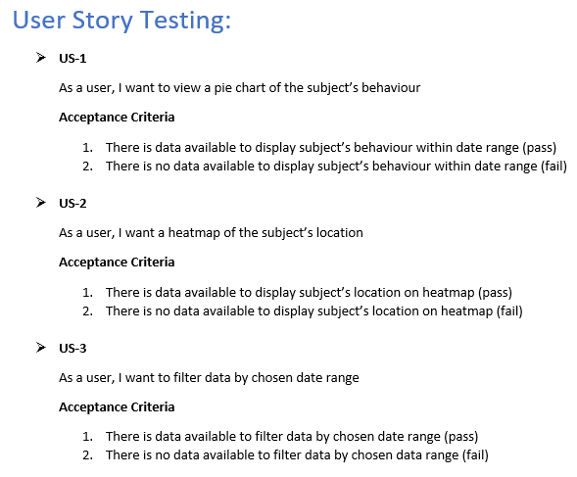
Testing (User Story Testing)
Notes:
JAMES

Slide 13
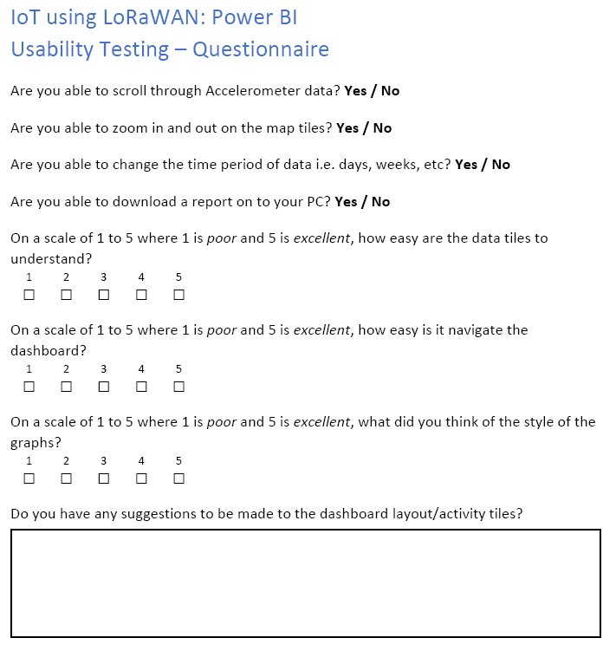
Testing (Usability Testing)
Additionally assess participants on whether:
Could users complete task?
How long did it take them?
Did they need help?
Create metrics from all pieces of data to obtain an insight into difficulties and problem areas
Notes:
REMI

Slide 14
Conclusion
Packet forwarder = missing link
Machine learning module
Full system testing
Notes:
JOEL

Slide 15


Q&A

